Slide 1
Course : 0553T / Multimedia System
Year : 2015
IMAGE
Session 03

Slide 2
OUTLINE
Image Definition
Image Media Types
3-D Drawing and Rendering
Color
Image File Format
Guidelines for the Use of Graphics

Slide 3
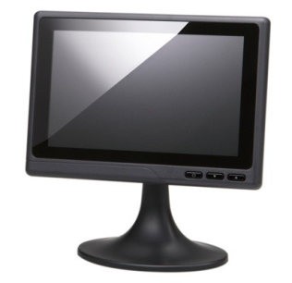
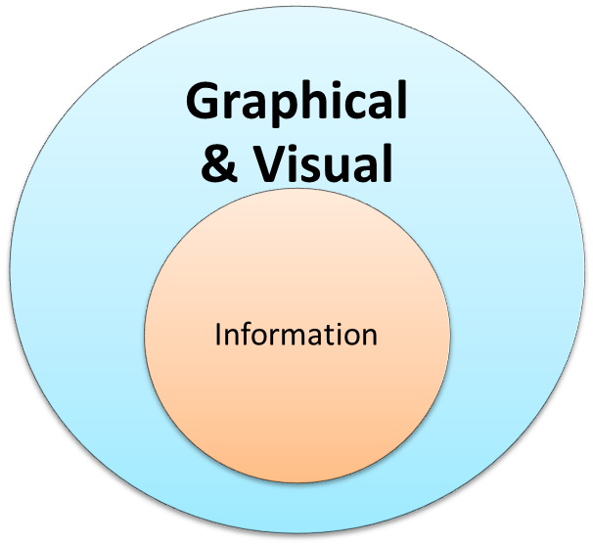
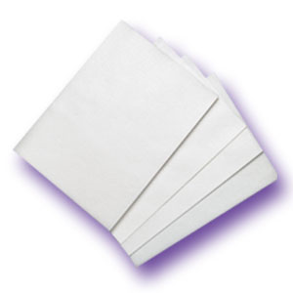
Image Definition
What is an Image

Slide 4
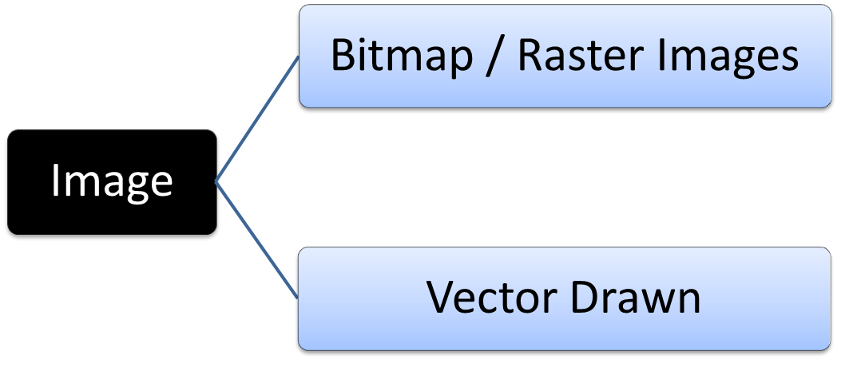
Image Media Types
The images are generated by computer in two ways :

Slide 5
Image Media Types
Bitmaps / Raster Image
  Sometimes called “painting program”
  Used for photorealistic images and for complex drawings requiring fine detail.
Vector Drawn
  Sometimes called “drawing program”
  Vector Drawn objects are used for lines, boxes, circles, polygons and other graphic shapes that can be mathematically expressed in angles, coordinates, and distances.

Slide 6
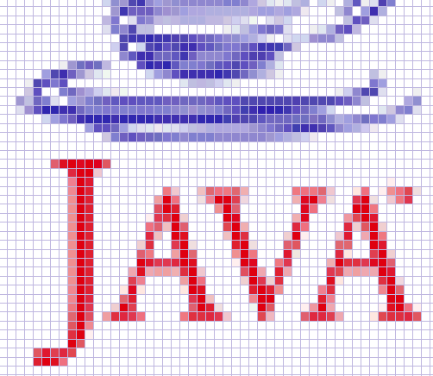

Image Media Types
Bitmaps : a simple matrix of the tiny dots that form an image and are displayed on a screen or printed.

Slide 7
Image Media Types
Bitmaps
  Each bit is most commonly set to black or white.
  a one dimensional matrix ( 1-bit depth) is used to display monochrome images
Bit Depth | Number of Colors Possible | Available Binary Combinations for Describing a Color
1 – bit | 2 ( 2¹) | 0, 1
2 – bit | 4 ( 2²) | 00, 01, 10, 11
4 – bit | 16 ( 2⁴) | 0000, 0001,0011, 0111 1111, 0010, 0100,1000, 0110,1100,1010,0101, 1110,1101,1001,1011

Slide 8
Image Media Types
Bitmap Software :
  Director : a powerful image editor that provides advanced tools such as “onion-skinning”
  Adobe Photoshop : the most widely used image-editing tool among designers worldwide.
  Photoshop Elements

Slide 9
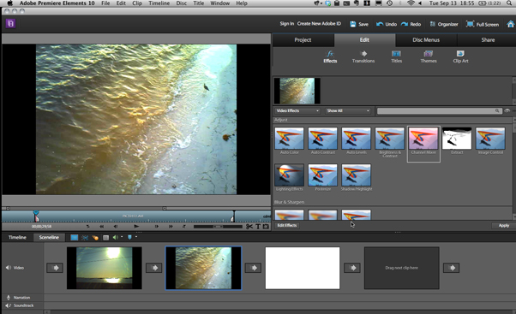
Image Media Types
Photoshop Elements 10 (www.macworld.com)

Slide 10
Image Media Types
Photoshop Elements 10 (www.macworld.com)

Slide 11
Image Media Types
  The quality of Bitmapped Images :
    Spatial resolution
      the measure of spatial resolution is ppi (pixels per inch).
      When the image is printed , spatial resolution is given as dpi ( dots per inch).
      In general, higher spatial resolutions captures more detail and produces sharper, more accurate images.

Slide 12
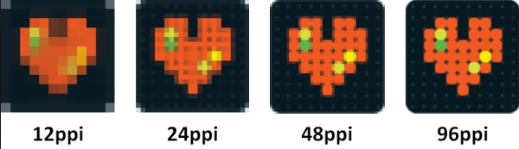
Image Media Types
  Example of an image with several ppi (community.giffgaff.com)

Slide 13
Image Media Types
    Color Resolution
      A measure of the number of different colors that can be represented by an individual pixel.
    The effect of low color resolution
      Low color resolution means that fewer colors will be available. If the image being displayed contains small number of colors, low color resolutions is not a problem.
      The effect of low color resolution can often be mitigated by color indexing or by another process known as dithering.

Slide 14
Image Media Types
    The effect of low color resolution
      In Color Indexing, a specific palette color is chosen to optimize the appearance of the lower-resolution image.
      Dithering is the process of combining pixels of different colors to produce another color that is not available.
      Color indexing and Dithering are still important considerations for developers who need to reduce image file size to optimize the performance of their application, particularly on the web.

Slide 15
Image Media Types
Vector-Drawn graphics
  The computer is given a set of command that it executes to draw the image.
  A vector is a line that is described by the location of its two endpoints.
  Vector drawing uses Cartesian Coordinates where a pair of numbers describes a point in two dimensional space as the intersection of horizontal and vertical lines. ( the x and y axes).

Slide 16
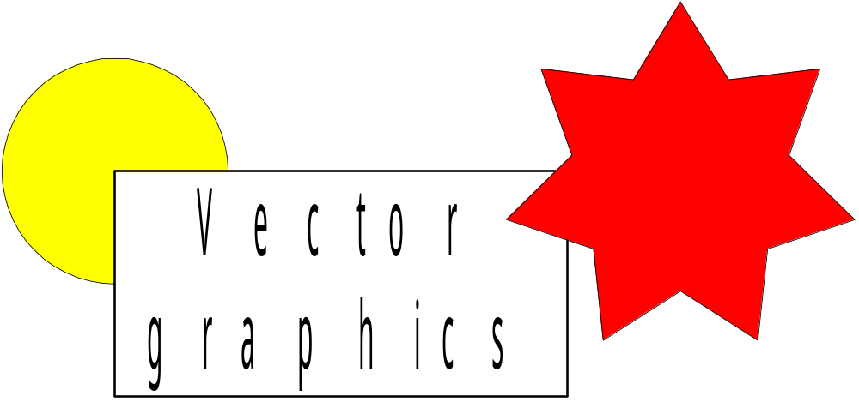
Image Media Types
Original image
Shown
magnified
Scaling vector drawn graphics

Slide 17

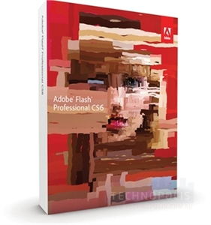
Image Media Types
Software to create vector images :
  Adobe Illustrator
  Adobe Freehand
  Adobe flash
  Microsoft Silverlight

Slide 18
Image Media Types
  Autotracing :
    Produces drawn graphics from bitmapped images.
    Autotraced files are particularly useful in web based application where their smaller size reduces download times.
  Rasterizing :
    Convert vector graphics to bitmapped images.

Slide 19
Image Media Types
Comparison Bitmapped and Vector Graphics
Bitmapped | Vector Graphics
Advantages | Advantages
Accurate representation of complex contone images such as photographs | Smooth scaling and reshaping
Full-featured photo editing ( sizing, cropping, tone, color adjustments | Ease of editing objects
Wide range of artistic effects | Low file sizes
Precision editing | Device-independent image resolution

Slide 20
Image Media Types
Comparison Bitmapped and Vector Graphics
Bitmapped | Vector Graphics
Disadvantages | Disadvantages
Large file sizes | Less detailed representation of complex contone images
Loss of precise shape when scaled or rotated | No Photo-editing capability
Device-dependent image resolution | Limited artistic control

Slide 21
3-D Drawing and
Rendering
3-D graphics application are the sophisticated, powerful programs. In 2-D graphics the computer is a helpful assistant. In 3-D graphics, it becomes a virtual partner in the creative process, using complex algorithms to create the finished images specified by the artist.
X
3D model
Y
Z

Slide 22
3-D Drawing and
Rendering
To model an object to place into a scene , start with a shape.
When extrude a plane surface, it extends its shape some distance, either perpendicular to the shape’s outline or along a defined path.
When lathe a shape, a profile of the shape is rotated around a defined axis ( you can set a direction) to create the 3-D object.
Once the 3-D object was created, apply textures and colors to make it seem more realistic whether rough and coarse or shiny and smooth.

Slide 23
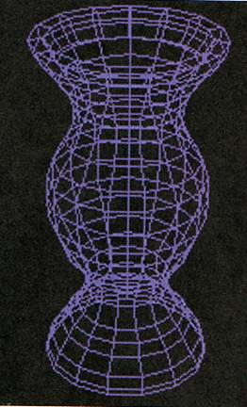
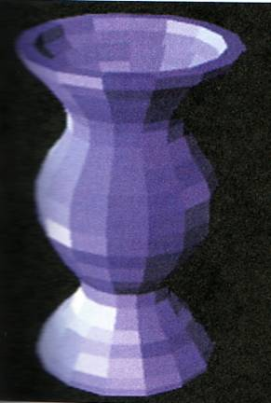
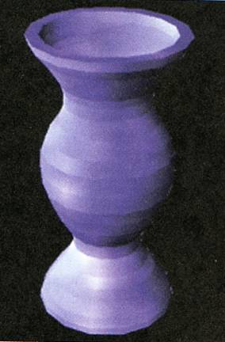
3-D Drawing and
Rendering
3-Dimensional Graphic models

Slide 24
3-D Drawing and
Rendering
There are four interconnected steps in the creation of 3-D images :
  Modeling
    Defines the three-dimensional shape of an object but not its surface texture.
  Surface definition
    Developers specify textures that are then applied to the model’s surface.
  Scene composition
    Objects are arranged, backgrounds are introduced, environmental effects are added, and lighting is established.
  Rendering
    After the modeling was completed, render it for final output. When the computer finally uses intricate algorithms to apply the effect that specified on the objects that created.

Slide 25
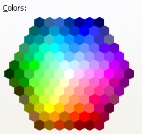
COLOR
Color :
  A vital component of multimedia.
  The frequency of a light wave within the narrow band of the electromagnetic spectrum to which the human eye responds.

Slide 26
COLOR
There are two basic methods of making color :
  Additive color
    A color is created by combining colored light sources in three primary colors : red, green, and blue (RGB).
  Subtractive color
    a color is created by combining colored media such as paints or ink that absorb (subtract) some parts of the color spectrum of light and reflect the others back to the eye.
    Four color printing includes black there are Cyan, magenta, yellow and black ( CMYK)

Slide 27
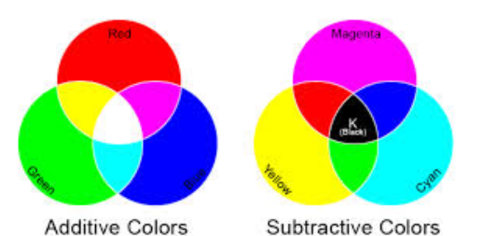
COLOR
  The fact that a paint program uses RGB to create the colors on your monitor while your printer uses CMYK to print out your image.

Slide 28
IMAGE FILE FORMAT
Most application on any operating system can manage JPEG, GIF, PNG and TIFF image format.
PICT : a older format used on the Macintosh
BMP : a common windows palette based image file format similar to PNG.
PCX : originally developed for use in Z-soft MS-DOS pain packages
TIFF : Tagged Interchange File Format, a universal bitmapped image format and used in desktop publishing packages.
PSD : file created by Adobe for Photoshop
AI : file created by Illustrator
CDR : file created by Corel

Slide 29
Color
Terminology of color in graphics design
  Primary Colors
  Secondary Colors
  Tertiary color
  Tints and shades
  Monochromatics color
  Analogous colors
  Complementary Colors
  etc

Slide 30
Guidelines for the Use of Graphics
Guidelines for the use of graphics :
  Identify the purpose of the graphic
  Choose the best format for each image
  Match graphic design to purpose
  Locate graphic design to purpose
  Preserve image quality
  Economize. Use graphics efficiently
  Organize graphics.

Slide 31
SUPPORTING MATERIAL
http://www.scantips.com/basics09.html
http://graphicssoft.about.com/od/aboutgraphics/a/bitmapvector_2.htm
http://www.webstyleguide.com/wsg3/11-graphics/index.html
http://en.wikipedia.org/wiki/Color_depth
http://www.cdli.ca/depted/g7/ortho.htm
http://graphicssoft.about.com/od/aboutgraphics/a/bitmapvector.htm
http://en.wikipedia.org/wiki/Image_compression

Slide 32
Exercise
Describe the capabilities and limitation of bitmap, vector and 3-D images!
Cite the various image file type used in multimedia.

